Slide 1





Hotel Room Booking Management
System
Mini Project Presenatation
Course : Coding and Decoding problem Solving

Slide 2


Introduction Of Our Team
Team Members:
Hari Priya - Requirement Analysis Lekha - System Design
Srujan - Development / Coding
Hema Varshini -Testing Sampath - Deployment
Harsha - Maintenance & Documentation
2

Slide 3


Project Overview
Hotel Booking Management System
A web-based system for hotel room booking
Automates booking and management process Reduces manual work
Improves customer experience
3

Slide 4






Problem Statement
Traditional hotel booking systems rely heavily on manual processes, which are time- consuming and prone to errors. Maintaining records on paper makes data management difficult and unreliable. Customers face inconvenience due to the lack of real-time room availability information. Hence, there is a need for an automated hotel booking management system to improve efficiency and accuracy.
Existing System Problems
Manual booking causes errors Time-consuming process
No real-time room availability Poor record management
Difficult for customers to book rooms easily

Slide 5


Objectives
To provide online room booking To manage hotel rooms efficiently
To store customer and booking details To reduce human errors
To improve booking speed and accuracy
Key Insights
The Hotel Booking Management System automates the booking process and reduces manual
effort.
It improves accuracy by providing real-time room availability and secure record management.
Overall, it enhances efficiency and user experience for both customers and hotel staff.
4

Slide 6
Concept Development
Approach Used : Software Deveplopment Life Cycle (SDLC)
Phases Used Why SDLC In our Project
A step-by-step process to develop software
Requirement Analysis System Design Implementation (Coding) Testing
Deployment Maintenance
Ensures quality and systematic development
Each phase has specific tasks
Helps in better planning and control
6

Slide 7
Phase 1: Requirement Analysis
Understand User Needs
Collect Hotel Booking Requirements Identify Functional Requirements Identify Non-Functional Requirements Prepare Requirements Document
HANDELED BY : HARI PRIYA
7

Slide 8
Phase 2: System Design
Design system architecture Create database structure Design user interface screens Define modules and flow Prepare design diagrams
HANDLED BY : LEKHA SAI
8

Slide 9
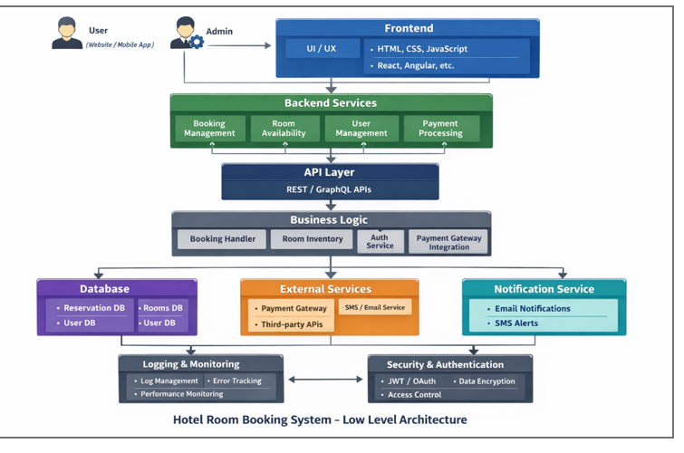

Slide 10

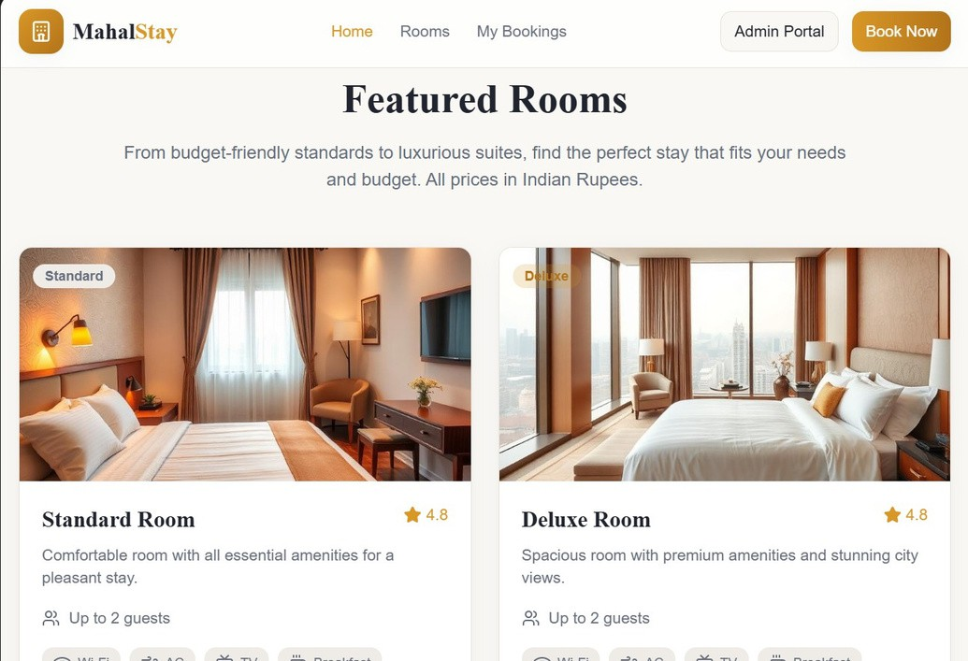
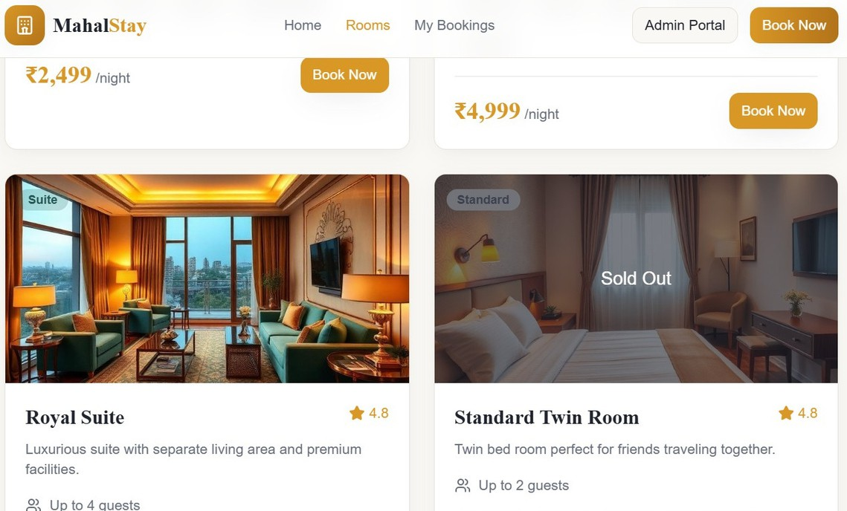
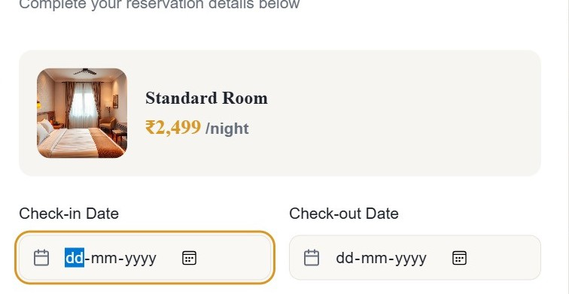
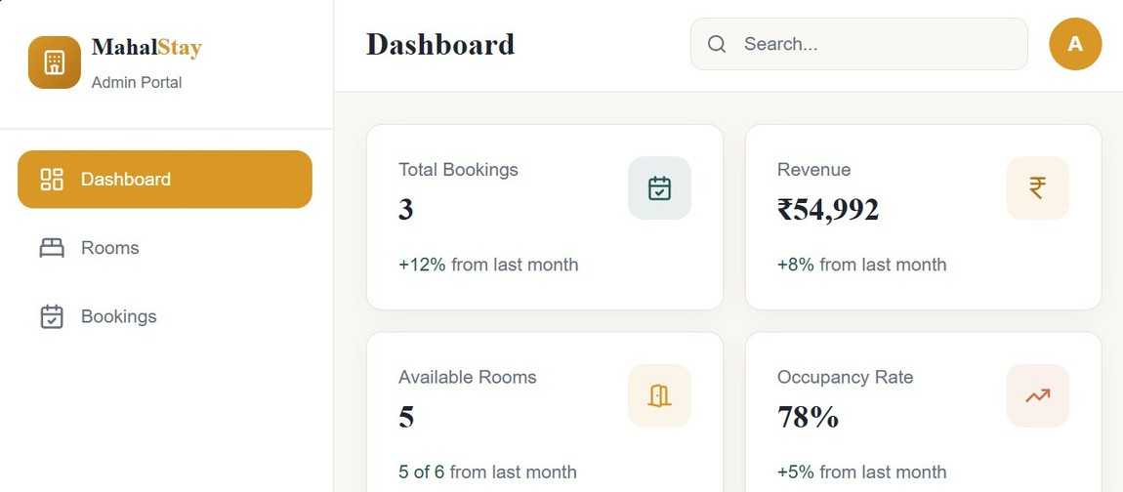

Slide 11

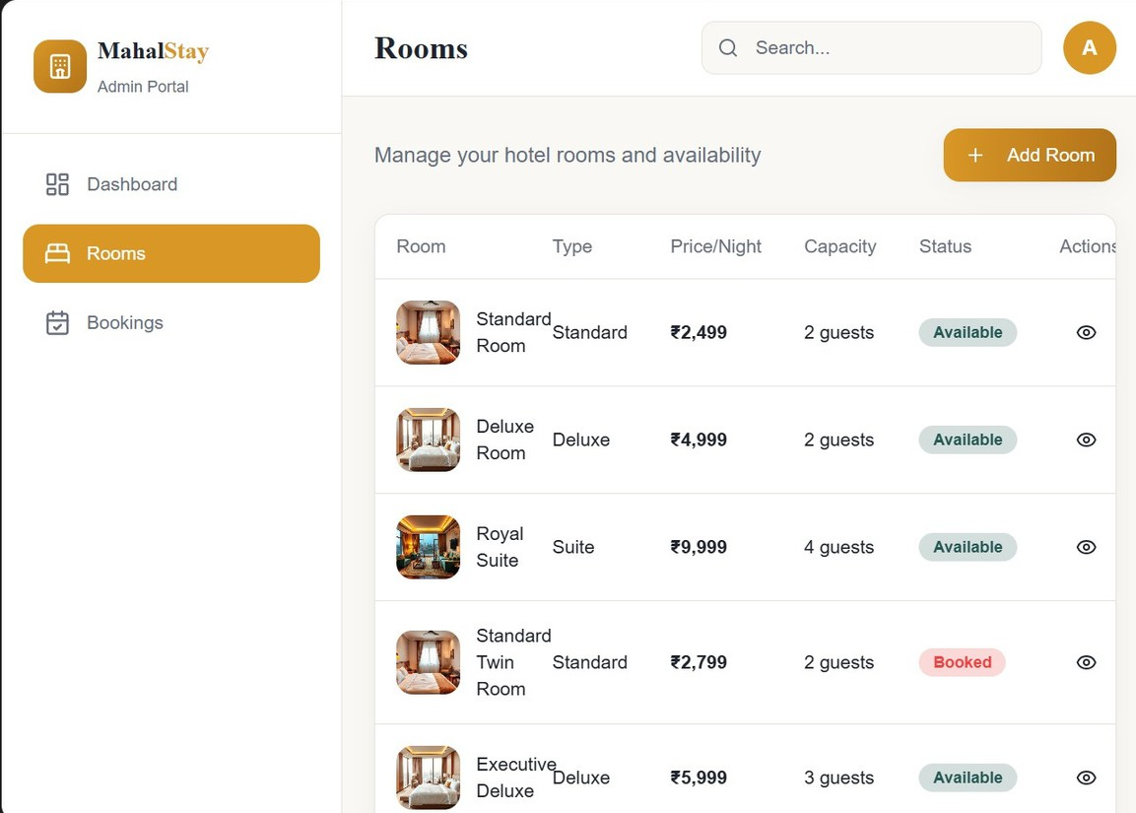
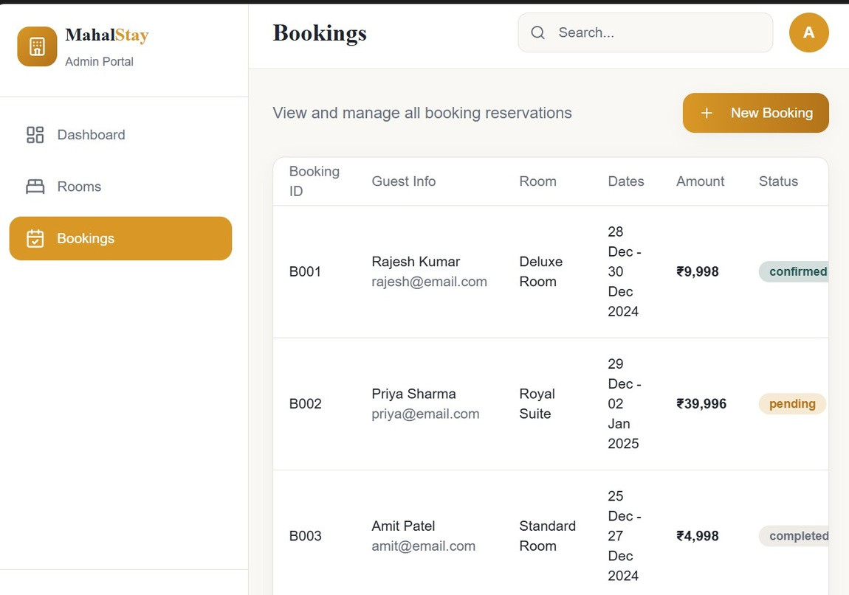
9

Slide 12

Phase 3: Implementation:
PROTOTYPE
TEAM A
Convert design into code Develop booking module
Develop admin module Connect database
Follow coding standards
HANDLED BY: SRUJAN RAVULA
10

Slide 13
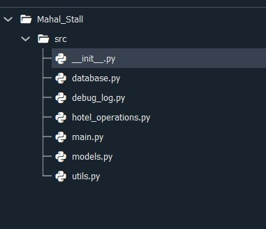
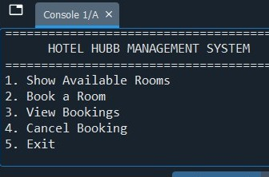
Folder
Structure:
Screenshot of program outputs showing 5 menu options:
11

Slide 14
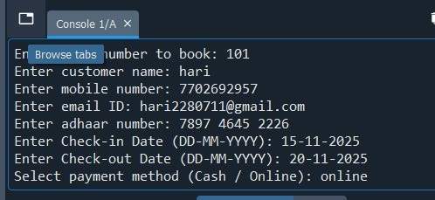
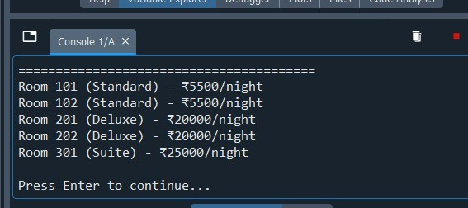
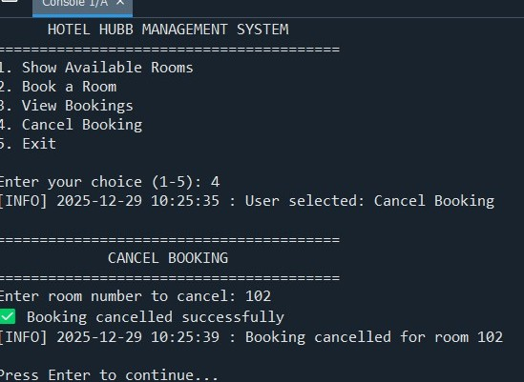
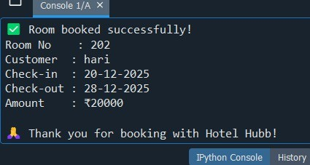
Screenshort Of Successful Execution Of Booking Operations
12

Slide 15
Check for errors and bugs
Perform unit testing Perform system testing Verify booking functionality Ensure correct output
Phase 4: Testing
HANDLED BY : HEMA VARSHINI

Slide 16
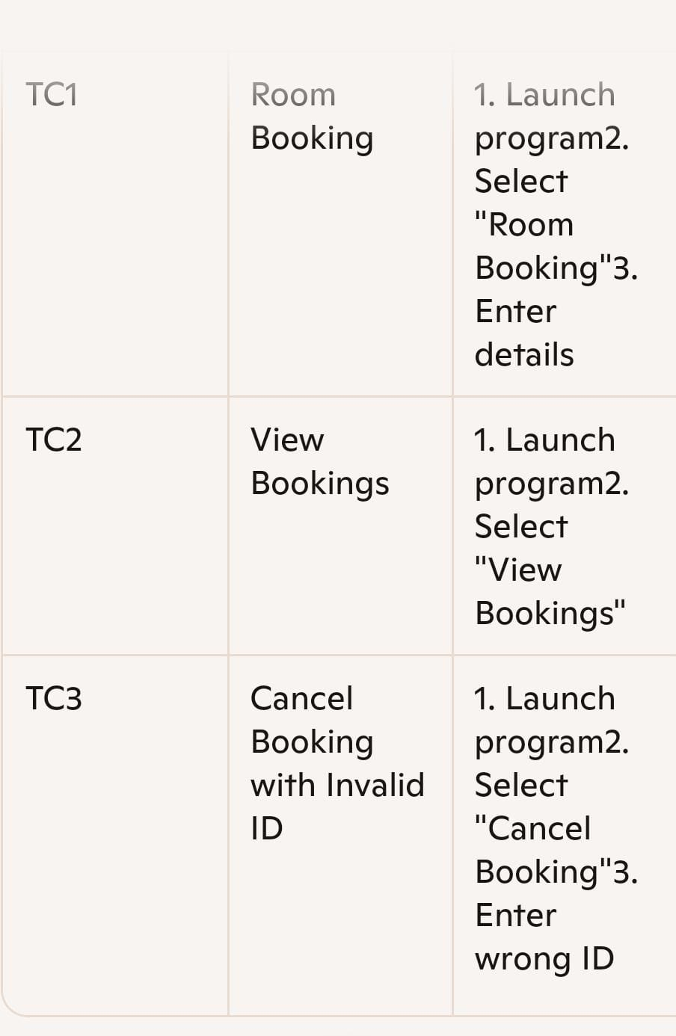

Slide 17
Install system on server
Configure database Make system live Provide user access Final verification
Phase 5: Deployment
HANDLED BY : G. SAMPATH

Slide 18
Fix future issues
Update system features Improve performance Handle user feedback
Phase 6: Maintenance
Ensure smooth operation
HANDLED BY : HARSHA

Slide 19
CONCLUSION :
The Hotel Booking Management System made the booking process easy and fast.
It reduced manual work and minimized errors in records. Customers can check room availability and book rooms easily. Hotel staff can manage bookings in a better way.
Overall, the system saved time and improved efficiency.

Slide 20
HOW SDLC APPROACH HELPED THIS PROJECT
Helped in systematic planning of the project
Clearly divided work among 6 team members Made requirements clear before development Reduced errors by following step-by-step phases Improved code quality and system design Helped in proper testing before deployment
Made the project easy to manage and understand

